Slide 1

Forest Protector
Forest Protector (youtube.com)

Slide 2
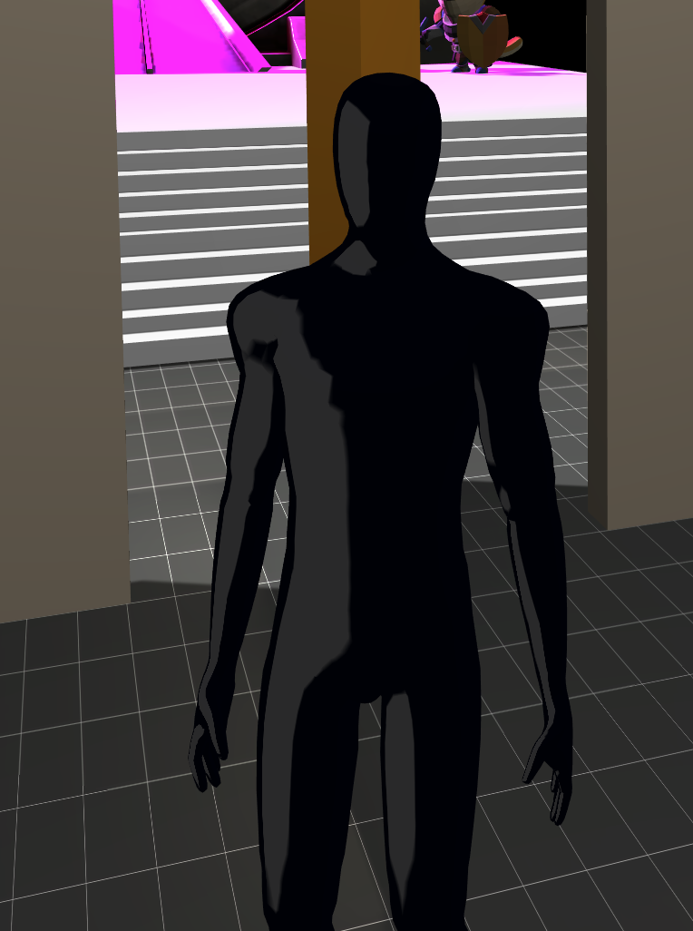
Game Backstory + Key Elements
The entry menu takes you to the lobby, where your guide awaits. As soon as you step through the portal, the guide will give you instructions. Once you arrive in the forest—don’t worry, the guide stays with you—you must eliminate five enemies hiding within the woods! Only then can you search for the next portal, which will lead you to the victory screen.
You play as the Guardian of the Forest, a dark and mysterious figure who resides in the woods. An enemy ship has arrived, seeking to conquer the forest due to its rich natural minerals. The Guardian (main player) realizes they cannot defeat all the invaders, but if they manage to eliminate five enemies, a portal will open, allowing them to escape. Surviving means living to fight another day and seeking revenge for the forest’s conquest (setting up a sequel).
The game includes a tutorial level and two main gameplay levels.

Slide 3
Explanation of the Scenes
Main Categories of Scenes:
Screens
Includes the main menu, game over screen, and victory screen—all sharing similar design elements.
Lobby Scene (Scene 1)
Functions as the introduction to the game.
The player receives instructions on the mission.
A portal is used to transition into the main game world, the dark forest.
Game Scene (Scene 2)
The primary gameplay scene, where the action takes place.
The player explores the dark forest, fights enemies, and progresses toward the objective.
After defeating five enemies, the player can find the portal to the victory screen.

Slide 4
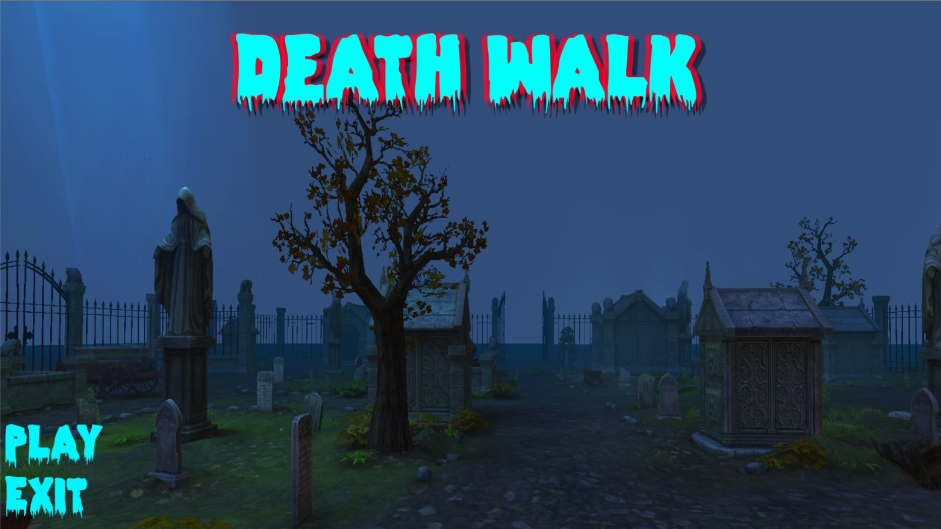
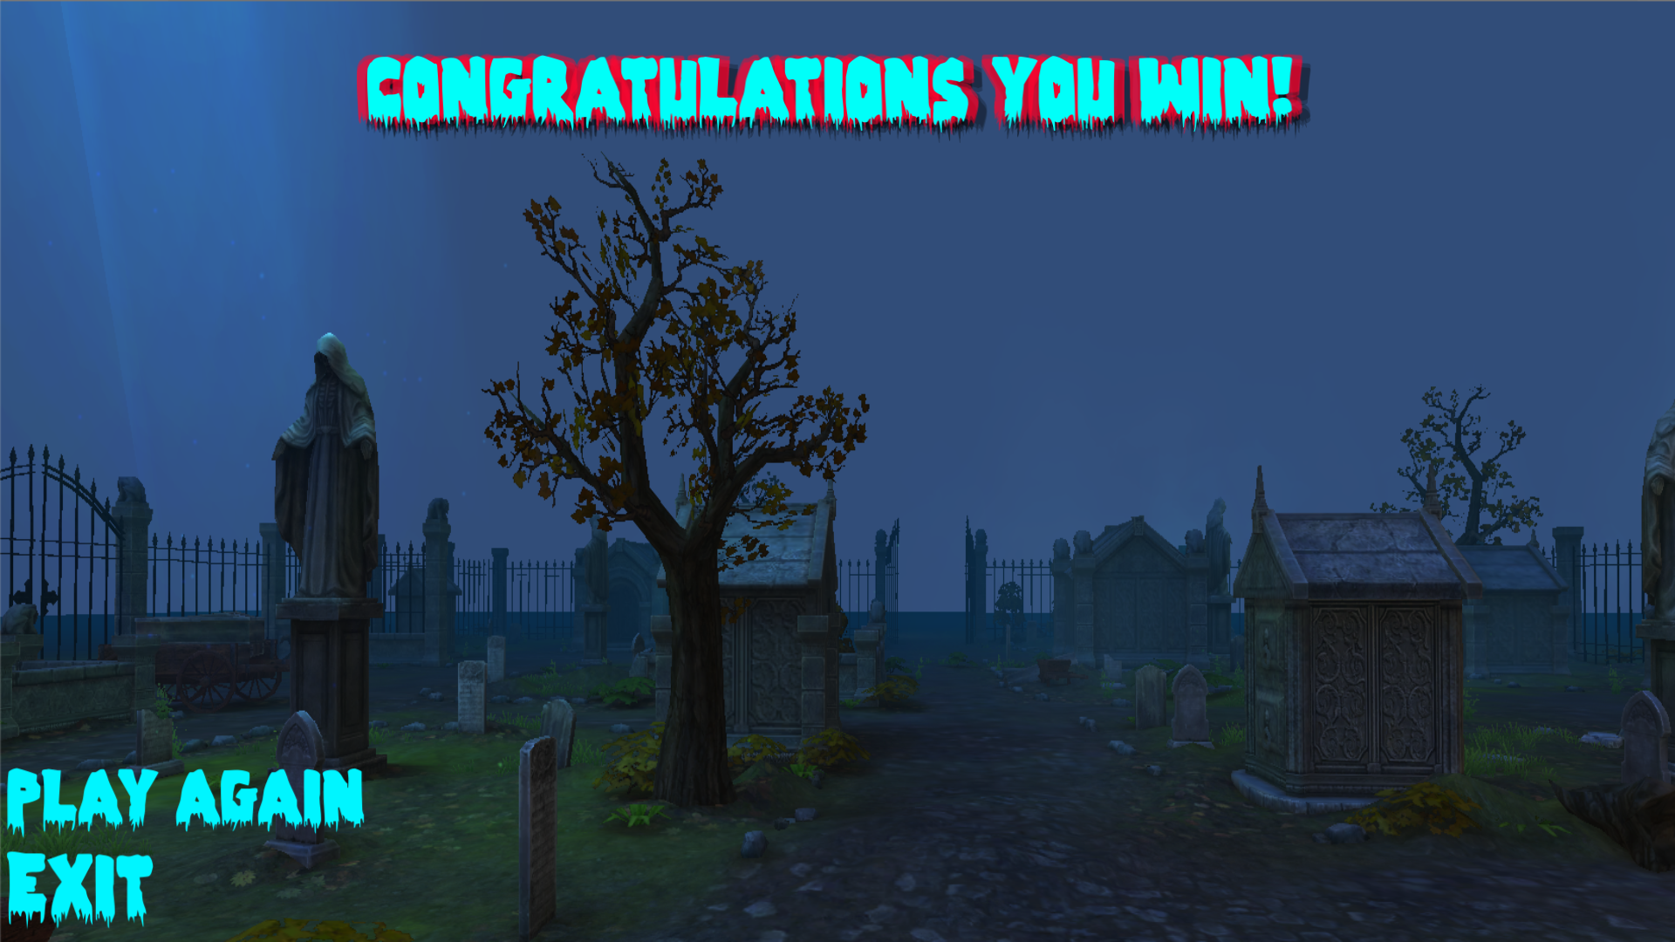
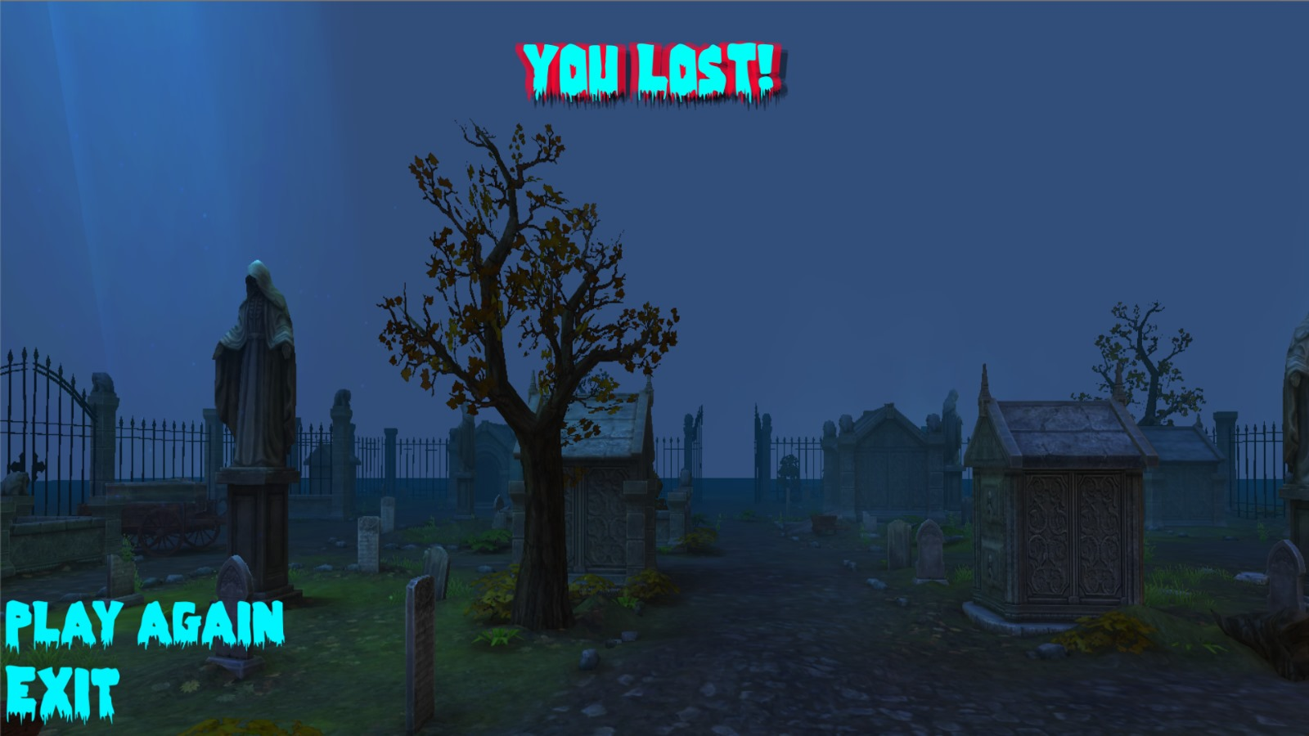
Entry and Victory Menu
Entry Menu
Victory Menu
Lose Menu

Slide 5
Lobby Scene - Features
In-Game Tutorial: Upon starting the game in the Lobby, the player receives instructions on the objectives and mission in the game, The guide character provides these instructions, helping players understand their role and what they need to do.
Portal Trigger: The portal acts as a trigger that transitions players from the Lobby into the actual game world, Additionally, if the player falls in the Lobby, a trigger will bring them back to the start of the Lobby.
Collision System: Players can walk on the surface to interact with the guide dog and change its color to blue, If the player collides with the dog, it will bark to alert the player of the collision.
Scene-to-Scene Parameter Transfer: The player's health from the Lobby scene is transferred to the next scene (the game world), The guide dog continues with the player into the next scene, following the color the player has selected.
Hinge Mechanism: In the Lobby, a hinge is used for the door opening, allowing players to interact with it.
Assets: The guide dog is an important asset in the game, providing both functional and interactive elements for the player.
Camera Angle Change: Inside the Lobby, players can adjust the camera angle using the mouse scroll wheel., By right-clicking, the player can switch the camera view from one shoulder to the other, giving them better control over the perspective.
Teleport Mechanism: The player can use a teleportation mechanic to quickly move from one point to another, especially useful in transitioning from the Lobby to the game world.
Building Mechanism: The Lobby scene includes the ability to build a house and use stairs, enhancing the player's interaction with the environment.

Slide 6
Game Scene - Features
Victory menu appears if you kill 5 enemies.
Loss menu appears if you're killed by an enemy.
Pressing the ESC key brings up the loss menu, asking whether you want to continue playing or quit.
Triggers: When you're shot from an unknown direction, a red marker appears indicating the general direction of the shot.
In the forest, pressing the 'E' key throws a ball – when two balls collide, a noise is heard.
The entire game terrain was designed using assets and hills based on class lessons (continuation of task 2).
Patrol with pauses: 11 enemies patrol the area, take breaks, and are aware of their surroundings to find the player.
Kill and health counters: The kill count uses PlayerPrefs to reload the scene upon death, and the kill count decreases by 1.
Parameter transfer: The dog’s skeleton can be changed in the lobby when stepping on the blue platform, and the skeleton will remain the same in the forest.
Assets: Shooting toolkit, house models, graves on the floor, and trees (used for terrain).
Enemy AI: Includes searching, fleeing, chasing, and navigation, with more than two types of agents moving on different patrol paths (baked separately).
Animator setup: Defined for the player, dog, enemy, etc.
Shooting and physical body impact: The player's gun (clearly visible in the game).
Using Recast with Stealth: Stealth mode activated by right-clicking.The shooting system, for both the player and enemy, uses LayerMasks and Recast to function.

Slide 7
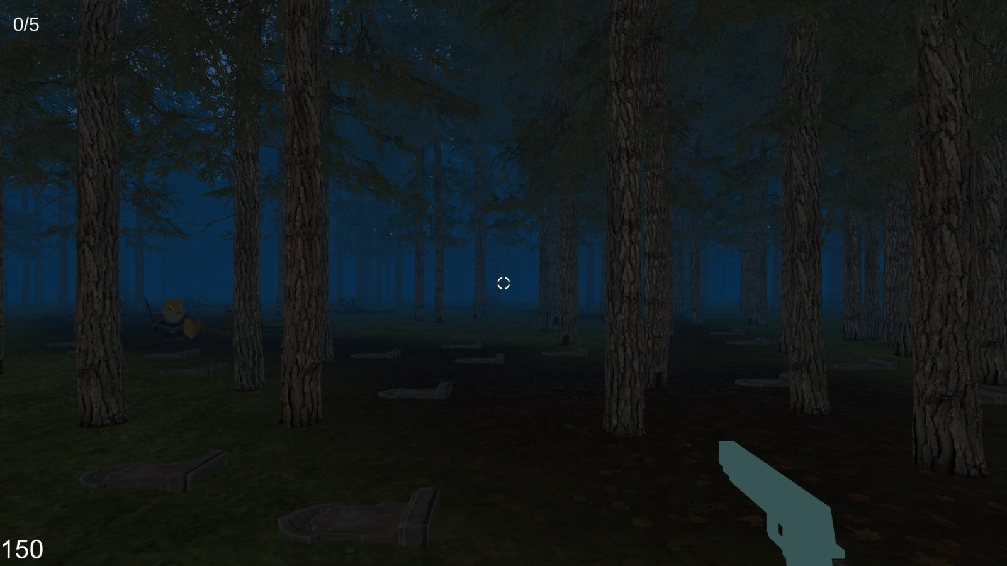
Accumulation or loss of score and health
Number of enemies killed
Life of character

Slide 8
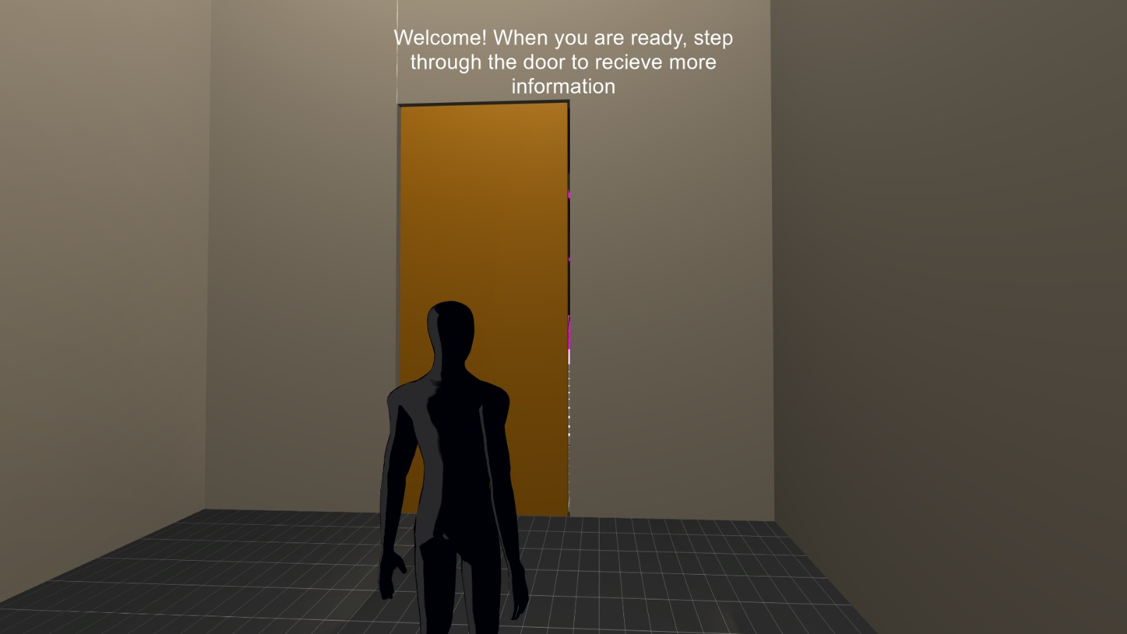
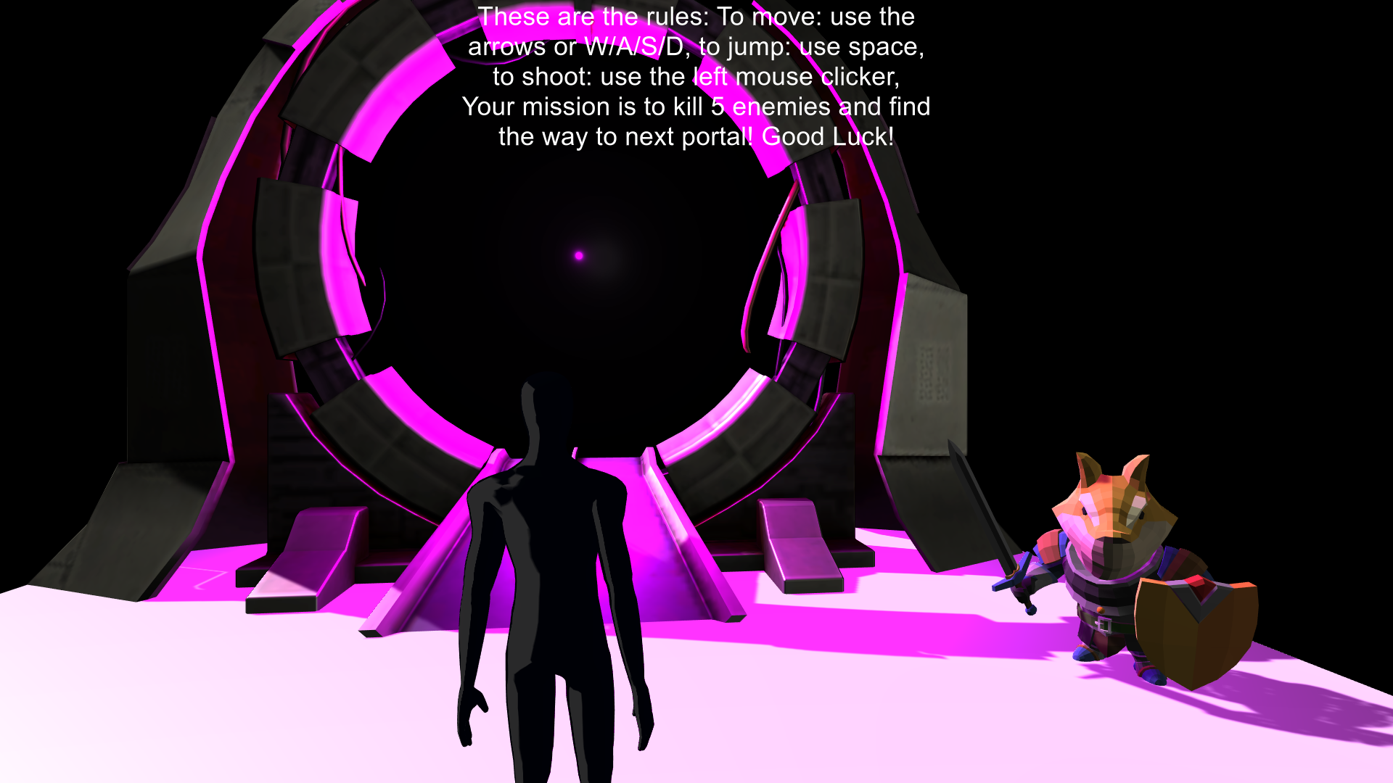
Textual tutorial in the 3D environment in the Lobby stage

Slide 9
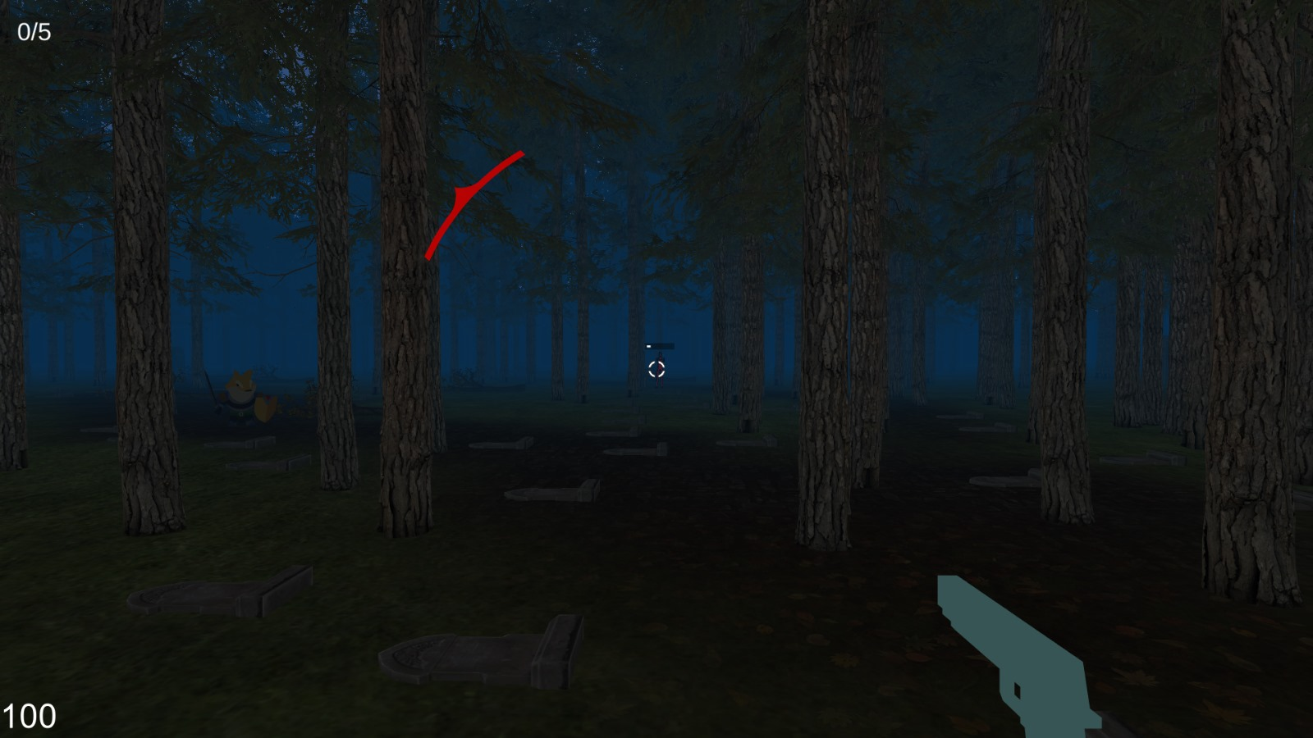
Triggers

Slide 10
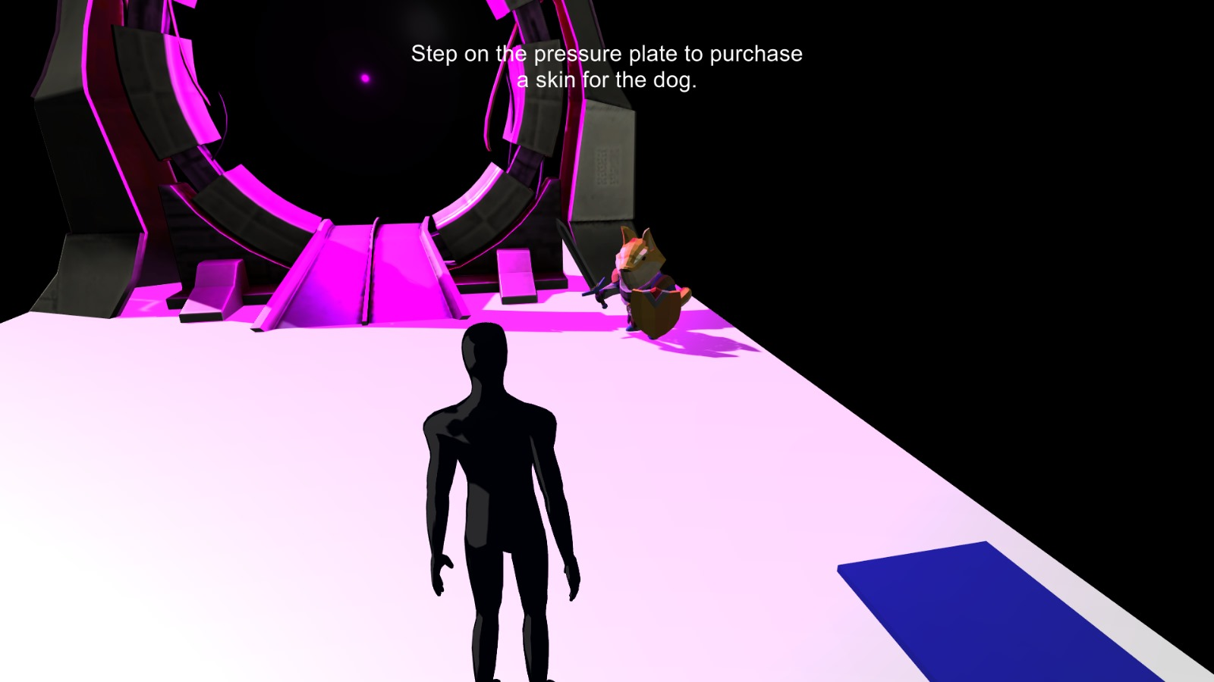
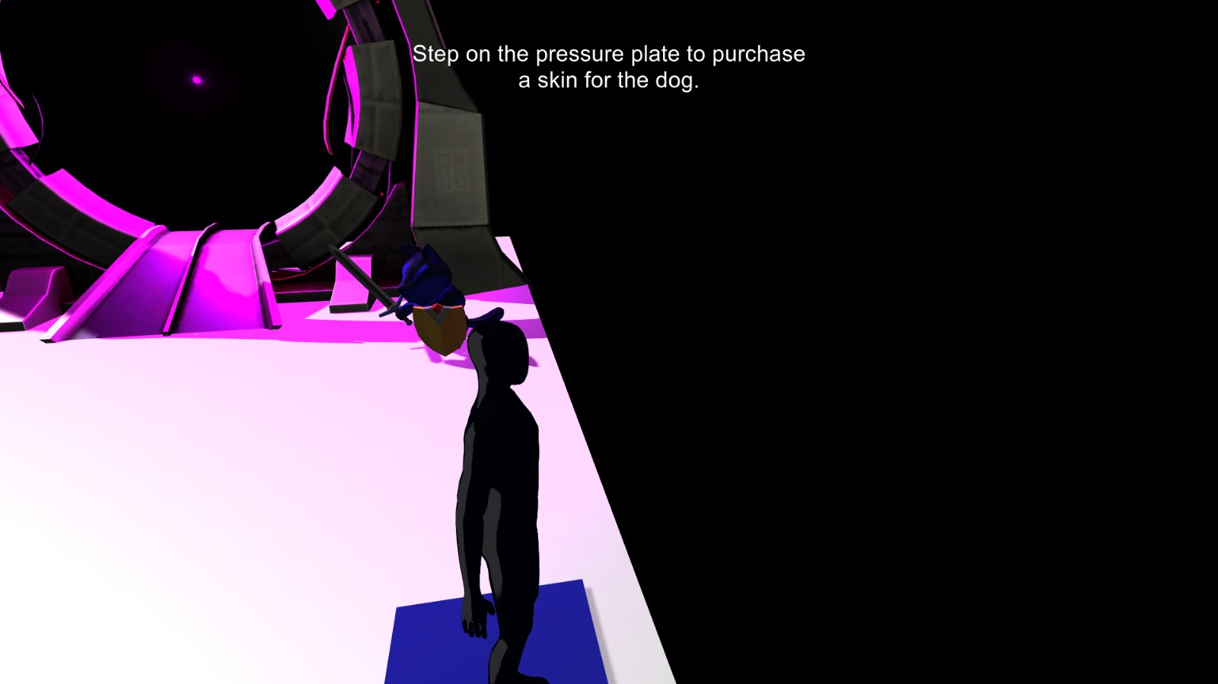
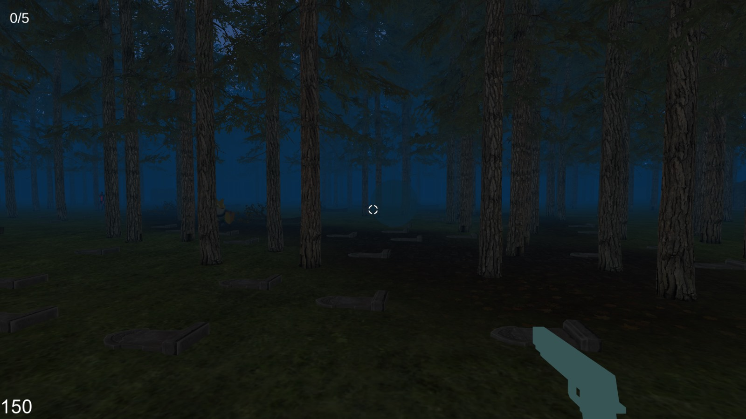
Collision
Change Color
Throw a ball

Slide 11
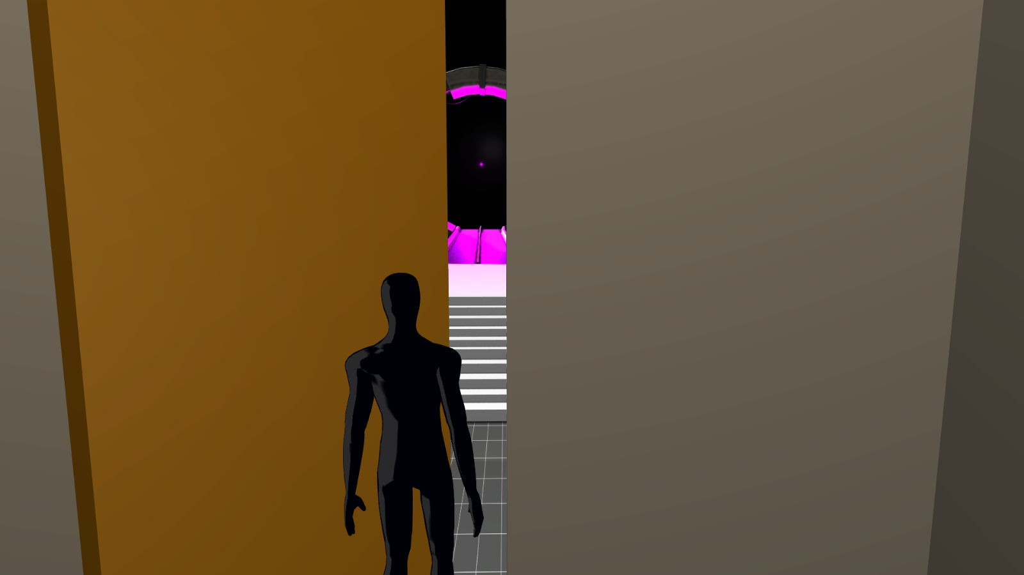
Hinge ,Rigid body
Open Door

Slide 12
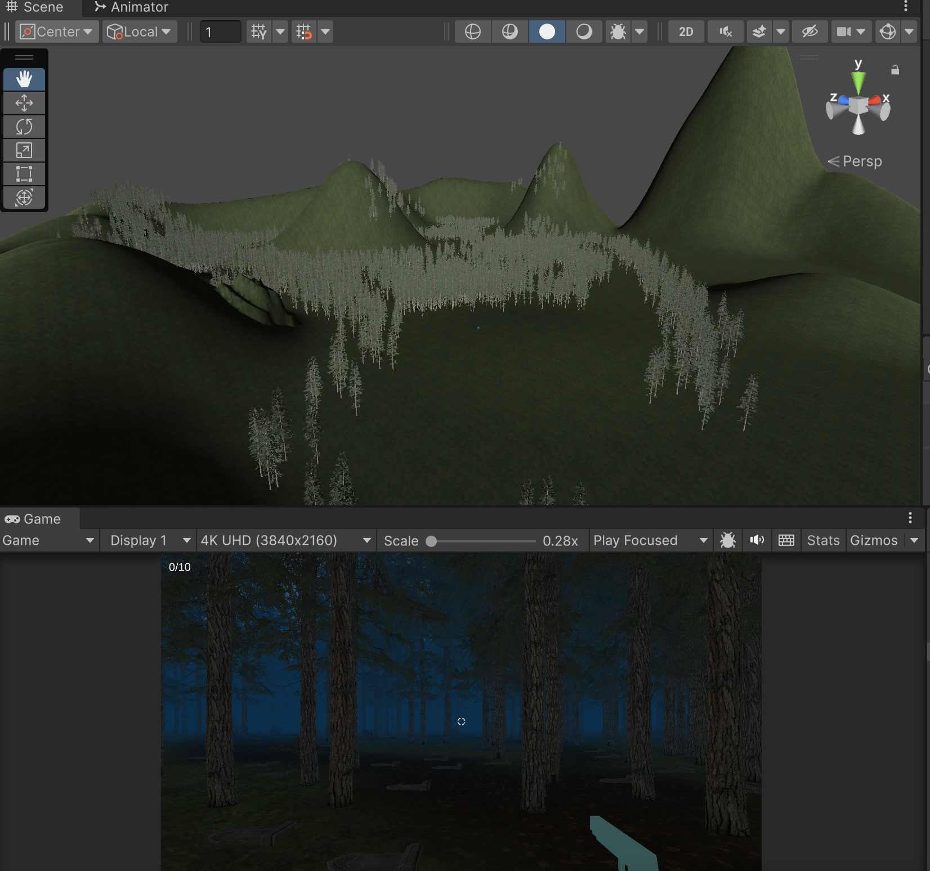
Self Built Terrain

Slide 13
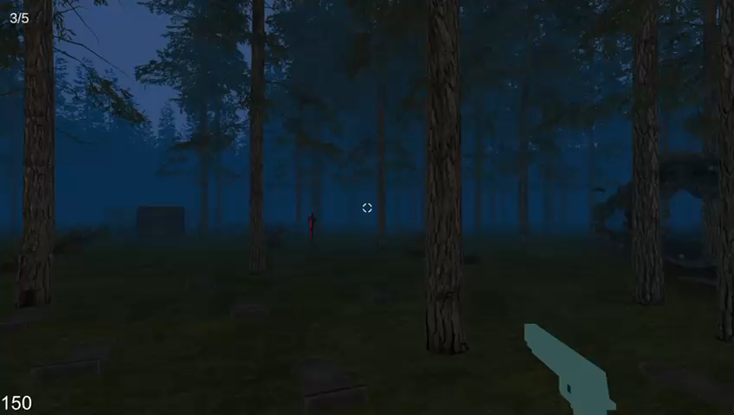
Explosion

Slide 14
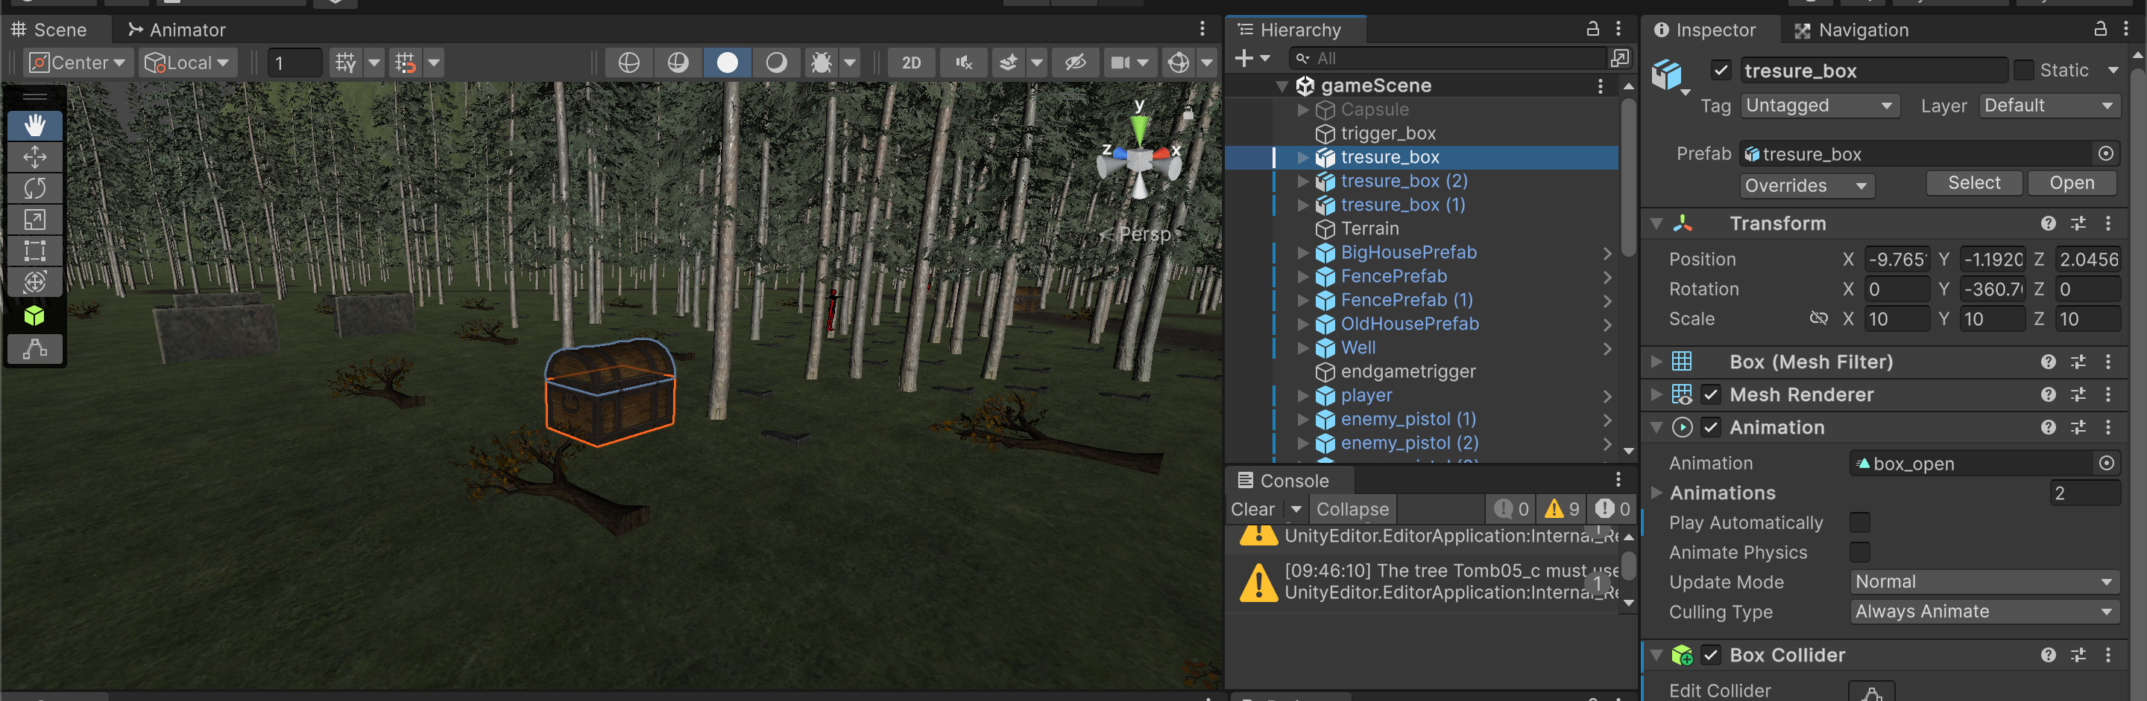
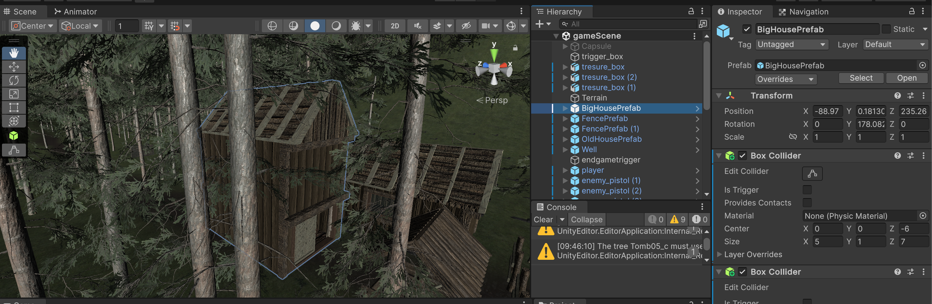
LOD ASSETS

Slide 15
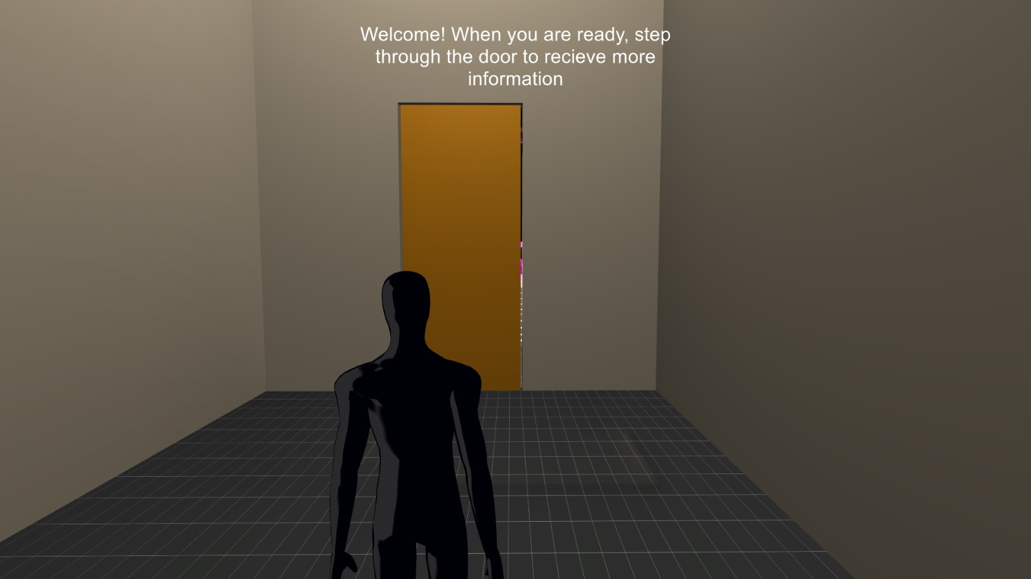
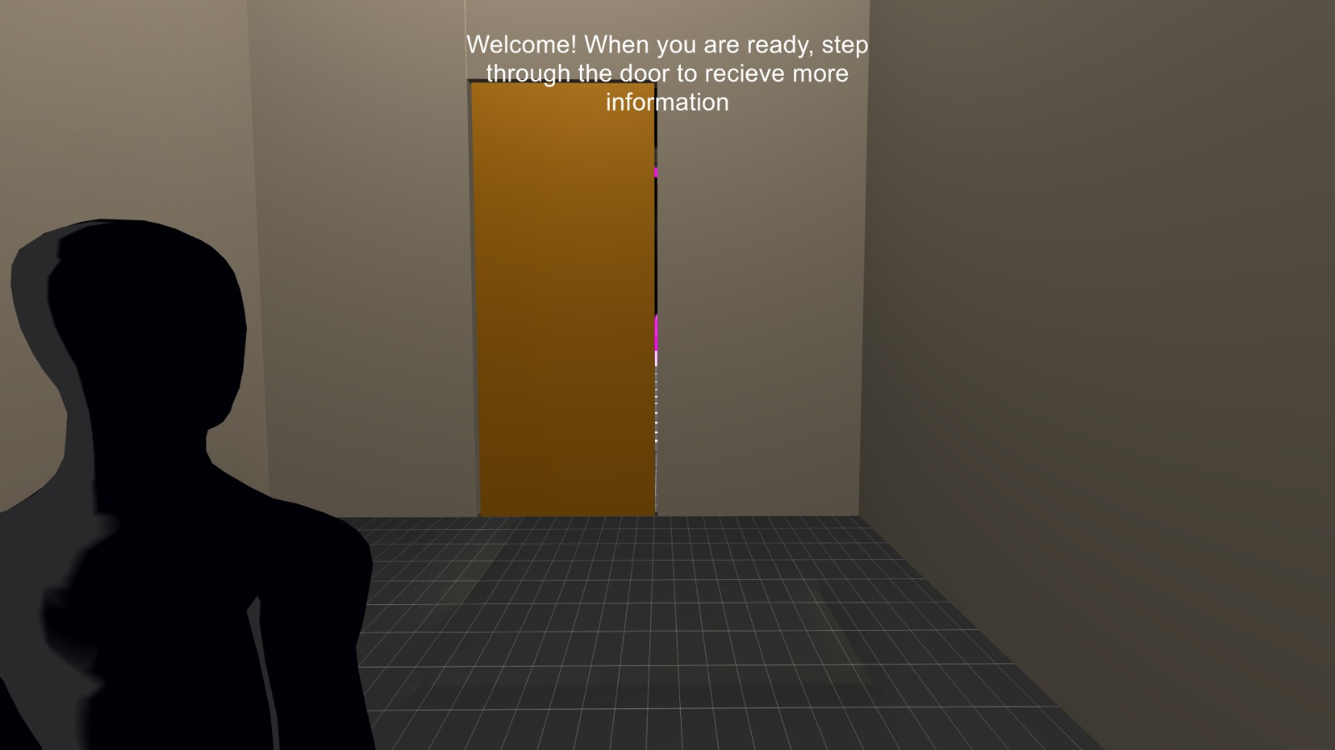
Switch Camera angle
Pressing the mouse wheel while holding the right-click button will switch the camera angle from one shoulder to the other.

Slide 16
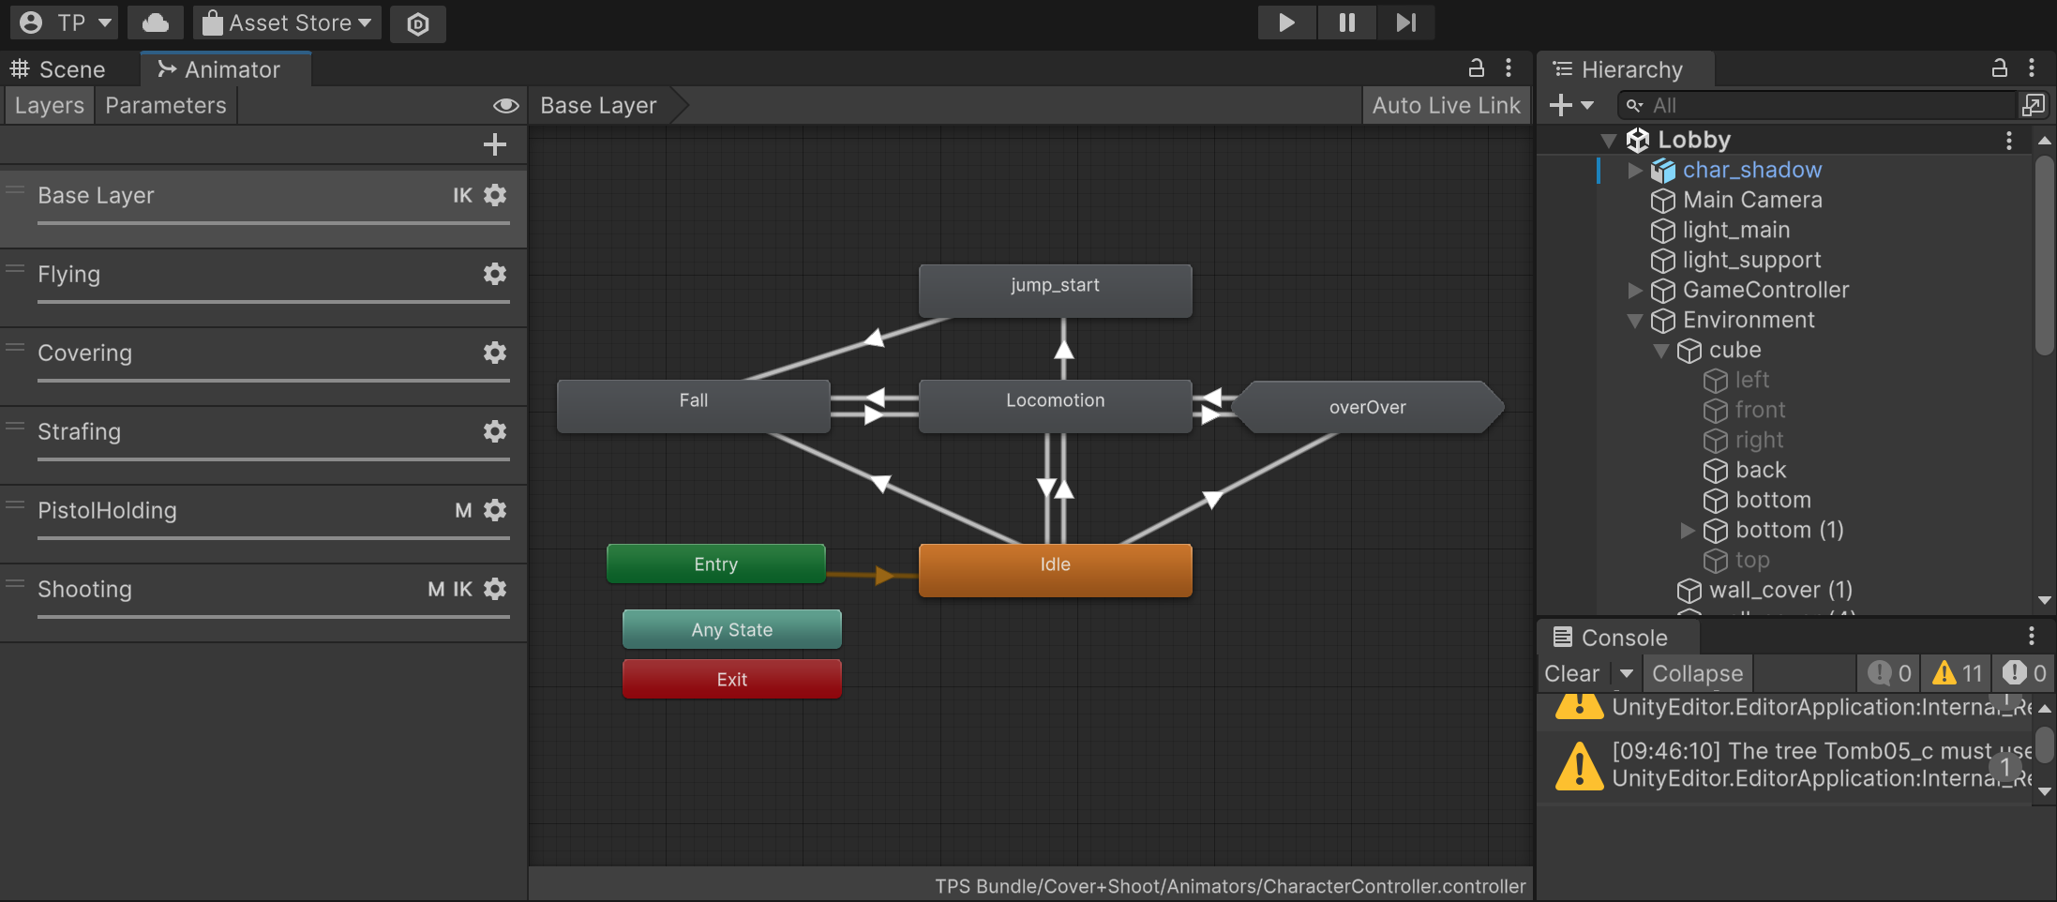
Animator

Slide 17
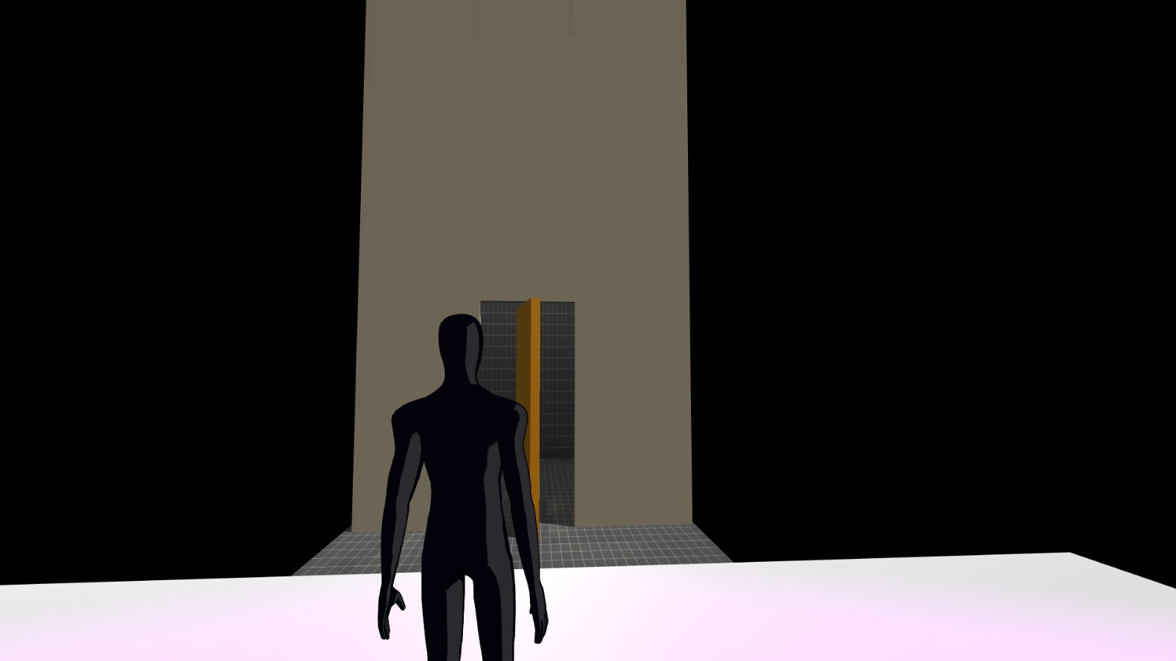
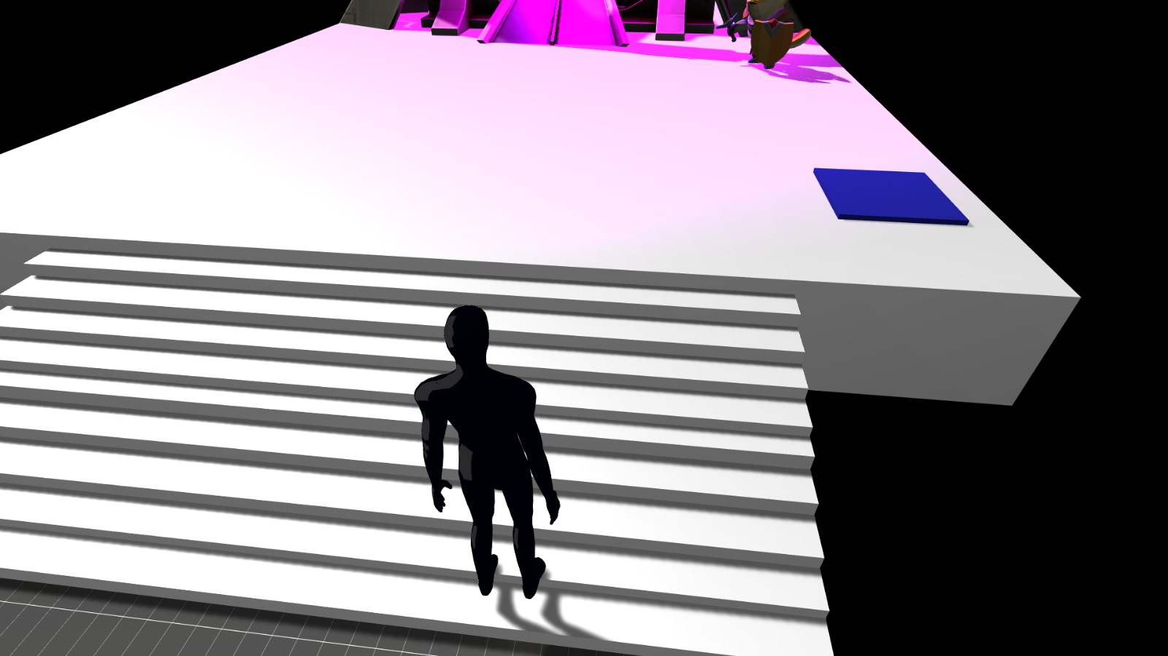
Building Room + Staircase

